Slide 1
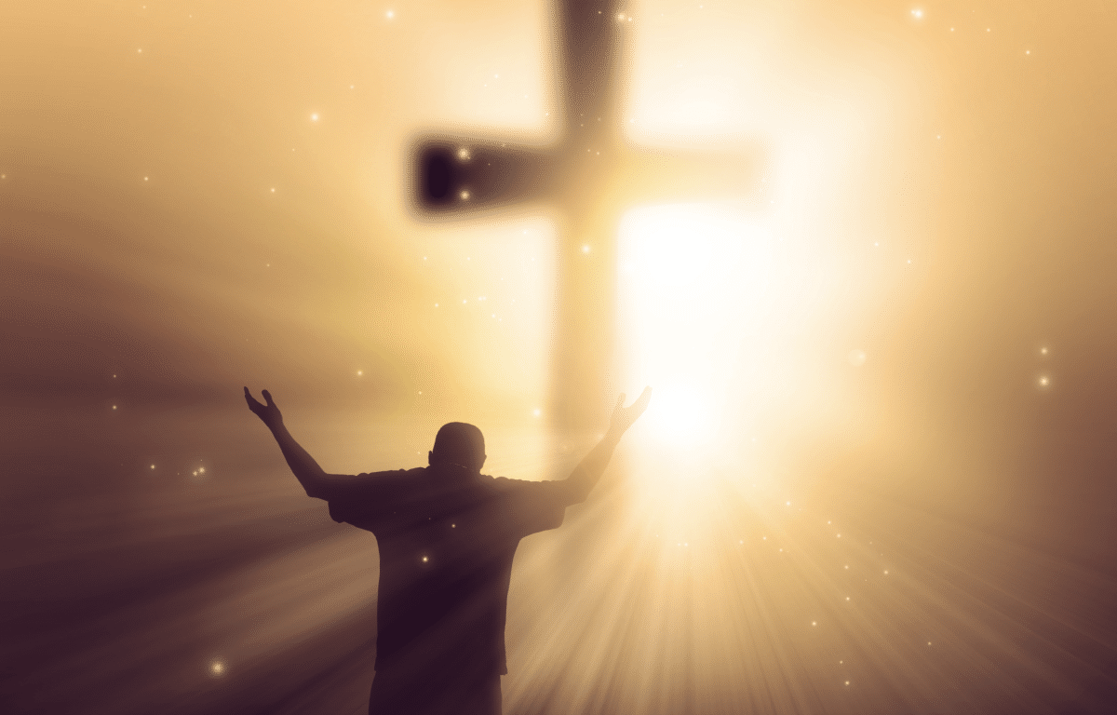
24th February 2019
Jesus or Nothing!
Philippians 3:1-11
Preached by Manik Corea on 24 Feb 2019 at Crossroads International Church Singapore • cicfamily.com Uploaded by Dr. Rick Griffith • Singapore Bible College Thousands of files in 49 languages for free at BibleStudyDownloads.org

Slide 2
‘Who are you?’

Slide 3
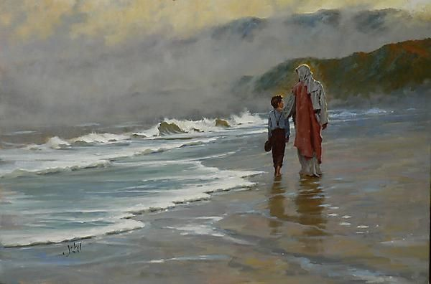
Rather, ‘Whose are you?’

Slide 4
Philippians 3:1-11 Jesus or Nothing!
The Gospel is not ‘Jesus + …..’ but
‘Jesus only’.
Therefore, we can ‘rejoice in the Lord’ (vs 1) - a key theme in the letter.

Slide 5
¹ Finally, my brothers, rejoice in the Lord! It is no trouble for me to write the same things to you again, and it is a safeguard for you.

Slide 6
Philippians 3:1-11 Jesus or Nothing!
16 references to ‘joy’ in Philippians.
‘I rejoice, now you do the same’ (John Bengel, commentator).

Slide 7
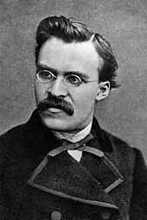
Frederick Nietzsche
‘When Christians looked more saved, I might become one.’

Slide 8
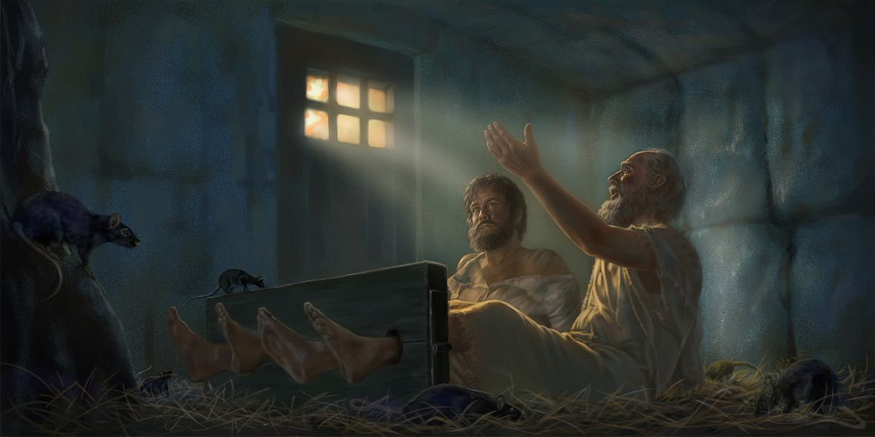
Paul and Silas in Prison (Acts 16:22-40)

Slide 9
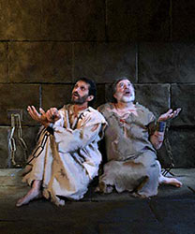
Acts 16:25
‘About midnight, Paul and Silas were praying and singing hymns to God’.

Slide 10
Philippians 3:1-11 Jesus or Nothing!
Joy:
1. ‘Rejoice that your names are written in heaven’ (Luke 10:20)
2. ‘Rejoice in hope’ (Rom 12:12)
3. ‘The Kingdom of God is…joy in the Holy Spirit.’ (Rom 14:17)
4. ‘The fruit of the Spirit is … joy.’ (Galatians 5:22).
5. ‘…we also rejoice in our afflictions, because we know that affliction produces endurance ... character ….and hope.’ (Rom 5:3)

Slide 11
¹ Finally, my brothers, rejoice in the Lord! It is no trouble for me to write the same things to you again, and it is a safeguard for you. 2 Watch out for those dogs, those evildoers, those mutilators of the flesh. 3 For it is we who are the circumcision, we who serve God by his Spirit, who boast in Christ Jesus, and who put no confidence in the flesh—
Party of Judaisers (Acts 15:1)

Slide 12
Philippians 3:1-11 Jesus or Nothing!
‘We are the true circumcision’
who put no confidence in the flesh’ (vs 3)
In Greek, ‘flesh’ is ‘sarx’ meaning our sinful or human nature.

Slide 13
⁴ though I myself have reasons for such confidence.
If someone else thinks they have reasons to put confidence in the flesh, I have more: ⁵ circumcised on the eighth day, of the people of Israel, of the tribe of Benjamin, a Hebrew of Hebrews; in regard to the law, a Pharisee; ⁶ as for zeal, persecuting the church; as for righteousness based on the law, faultless.

Slide 14
Philippians 3:1-11 Jesus or Nothing!
Paul says he was:
a) circumcised – RELIGIOUS

Slide 15
⁴ though I myself have reasons for such confidence.
If someone else thinks they have reasons to put confidence in the flesh, I have more: ⁵ circumcised on the eighth day, of the people of Israel, of the tribe of Benjamin, a Hebrew of Hebrews; in regard to the law, a Pharisee; ⁶ as for zeal, persecuting the church; as for righteousness based on the law, faultless.

Slide 16
Philippians 3:1-11 Jesus or Nothing!
Paul says he was:
a) RELIGIOUS
b) Of the people of Israel by birth –
(NATIONALITY)

Slide 17
⁴ though I myself have reasons for such confidence.
If someone else thinks they have reasons to put confidence in the flesh, I have more: ⁵ circumcised on the eighth day, of the people of Israel, of the tribe of Benjamin, a Hebrew of Hebrews; in regard to the law, a Pharisee; ⁶ as for zeal, persecuting the church; as for righteousness based on the law, faultless.

Slide 18
Philippians 3:1-11 Jesus or Nothing!
Paul says he was:
a) RELIGIOUS
b) A NATIONAL OF ISRAEL
C) Of tribe of Benjamin – FAITHFUL
TRIBE

Slide 19
⁴ though I myself have reasons for such confidence.
If someone else thinks they have reasons to put confidence in the flesh, I have more: ⁵ circumcised on the eighth day, of the people of Israel, of the tribe of Benjamin, a Hebrew of Hebrews; in regard to the law, a Pharisee; ⁶ as for zeal, persecuting the church; as for righteousness based on the law, faultless.

Slide 20
Philippians 3:1-11 Jesus or Nothing!
Paul says he was:
a) RELIGIOUS
b) A NATIONAL
c) OF THE RIGHT TRIBE
d) A Hebrew of Hebrews – A TRUE
JEW

Slide 21
⁴ though I myself have reasons for such confidence.
If someone else thinks they have reasons to put confidence in the flesh, I have more: ⁵ circumcised on the eighth day, of the people of Israel, of the tribe of Benjamin, a Hebrew of Hebrews; in regard to the law, a Pharisee; ⁶ as for zeal, persecuting the church; as for righteousness based on the law, faultless.

Slide 22
Philippians 3:1-11 Jesus or Nothing!
Paul says he was:
a) RELIGIOUS
b) A NATIONAL OF ISRAEL
c) OF THE RIGHT TRIBE
d) A TRUE JEW
e) A Pharisee – RIGHT EDUCATION

Slide 23
⁴ though I myself have reasons for such confidence.
If someone else thinks they have reasons to put confidence in the flesh, I have more: ⁵ circumcised on the eighth day, of the people of Israel, of the tribe of Benjamin, a Hebrew of Hebrews; in regard to the law, a Pharisee; ⁶ as for zeal, persecuting the church; as for righteousness based on the law, faultless.

Slide 24
Philippians 3:1-11 Jesus or Nothing!
Paul says he was:
a) RELIGIOUS
b) A NATIONAL OF ISRAEL
c) OF THE RIGHT TRIBE
d) A TRUE JEW
e) EDUCATED BY THE BEST
f) ZEALOUS
g) FAULTLESS

Slide 25
⁷ But whatever were gains to me I now consider loss for the sake of Christ. ⁸ What is more, I consider everything a loss because of the surpassing worth of knowing Christ Jesus my Lord, for whose sake I have lost all things. I consider them garbage, that I may gain Christ ⁹ and be found in him, not having a righteousness of my own that comes from the law, but that which is through faith in Christ—the righteousness that comes from God on the basis of faith.

Slide 26
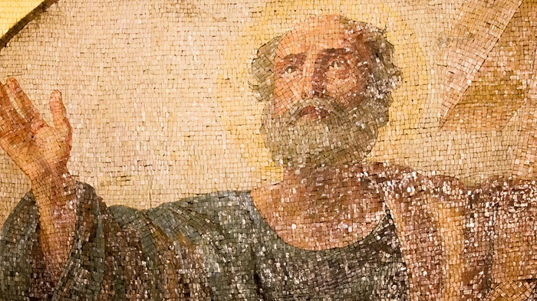
The Resume/CV of the Apostle Paul

Slide 27
Philippians 3:1-11 Jesus or Nothing!
Paul says he was:
a) RELIGIOUS
b) A NATIONAL OF ISRAEL
c) OF THE RIGHT TRIBE
d) A TRUE JEW
e) EDUCATED BY THE BEST
f) ZEALOUS
g) FAULTLESS
But all this he considered WORTHLESS compared to knowing CHRIST!

Slide 29
⁷ But whatever were gains to me I now consider loss for the sake of Christ. ⁸ What is more, I consider everything a loss because of the surpassing worth of knowing Christ Jesus my Lord, for whose sake I have lost all things. I consider them garbage, that I may gain Christ ⁹ and be found in him, not having a righteousness of my own that comes from the law, but that which is through faith in Christ—the righteousness that comes from God on the basis of faith. ¹⁰ I want to know Christ—yes, to know the power of his resurrection and participation in his sufferings, becoming like him in his death, ¹¹ and so, somehow, attaining to the resurrection from the dead.

Slide 30
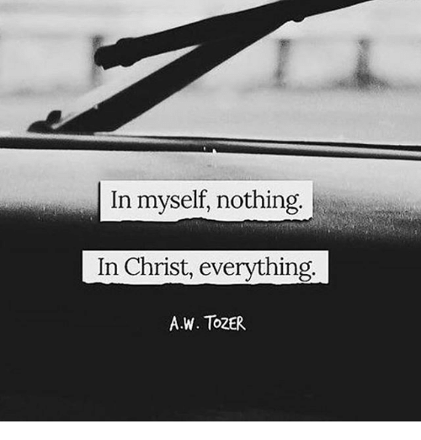

Slide 31
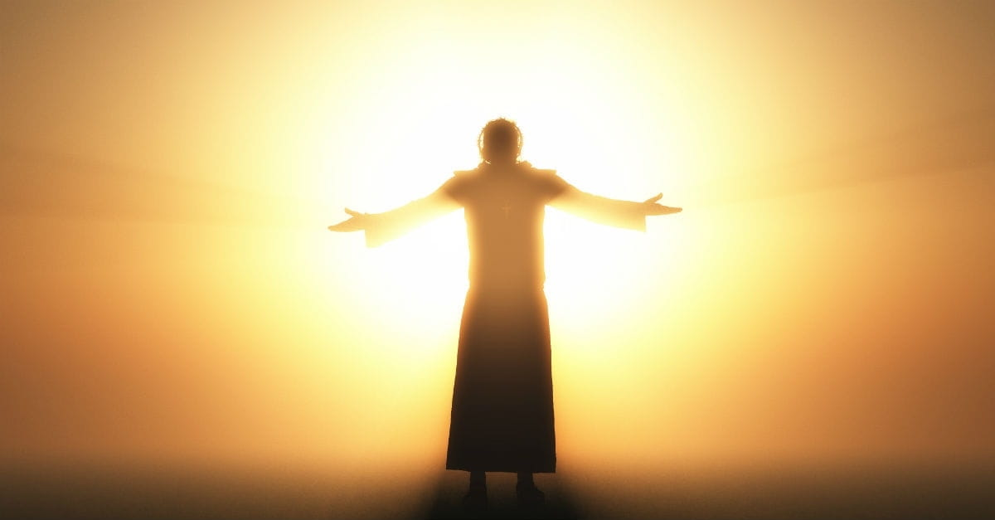
Philippians 3:1-11 Jesus or Nothing!
APPLICATION – The ‘So what’ question
‘I’ll follow Jesus if…’
VS
‘I’ll follow Jesus even if..’
To Know Christ and
to make Him Known

Slide 32
Philippians 3:1-11 Jesus or Nothing!
LET US PRAY

Slide 33
Black

Slide 34
NT Preaching link at BibleStudyDownloads.org
Get this presentation for free!

